Slide 1
File Handling/IO streams/File IO

Slide 2
In Java, with the help of File Class, we can work with files.
This File Class is inside the java.io package.
The File class can be used by creating an object of the class and then specifying the name of the file.

Slide 3
IO streams providing API(Predefined classes):-
1)For storing data inside a file
2)For reading data from the file
3)For reading data from keyboard
4)For display value on console

Slide 4
System.in
Keyboard
ABC.txt
IO streams
(Predefined classes)
System.out
Console
System.err

Slide 6
Basic need
Read data from file
Store data permanently.

Slide 7
If I don’t use IO
So,we are using databases.
Interaction to the databases are done by JDBC API
suppose
Class College
Student name,id,marks,age
Object 1
Object 2
-
-
Object n
write
File system
For sending data to remote files,and databases we use Networking API,so base for JDBC API and NetworkingAPI is IO streams
Read
If we want to store this values permanently we have to store it in files(secondary memory)
Object values get destroyed after termination.(Program is executing in RAM)
But files are not secure,also not organized well,proper order is not there,we don’t have searching algorithm.

Slide 8
What is stream?
Stream is connection between java program and file.
Stream is logical connection.
Java Application
ABC.txt
Output Stream
Input Stream

Slide 9
Type of streams:-based on direction of data send
Input stream(input to the java program from file)-reading
Output Stream(output to the file from java program)-writing

Slide 10
Format for sending data in java in streams:-streams are of 2 types
Binary(0,1)
Binary input stream
Binary output stream
Character
Character input stream(reader)
Character output stream(writer)

Slide 11
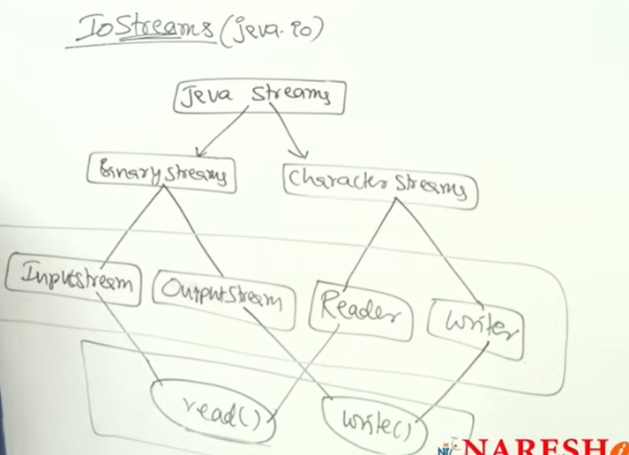

Slide 12
Inputstream classes and subclasses
1. Input Stream:
The Java InputStream class is the superclass of all input streams. The input stream is used to read data from numerous input devices like the keyboard, network, etc. InputStream is an abstract class, and because of this, it is not useful by itself. However, its subclasses are used to read data.

Slide 13
Output stream classes and subclasses
2. Output Stream:
The output stream is used to write data to numerous output devices like the monitor, file, etc. OutputStream is an abstract superclass that represents an output stream. OutputStream is an abstract class and because of this, it is not useful by itself. However, its subclasses are used to write data.

Slide 14
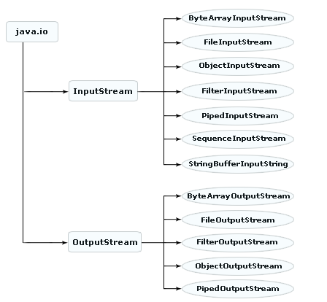

Slide 15
InputStream and OutputStream are abstract classes:-
Inputstream class providing 9 methods

Slide 16
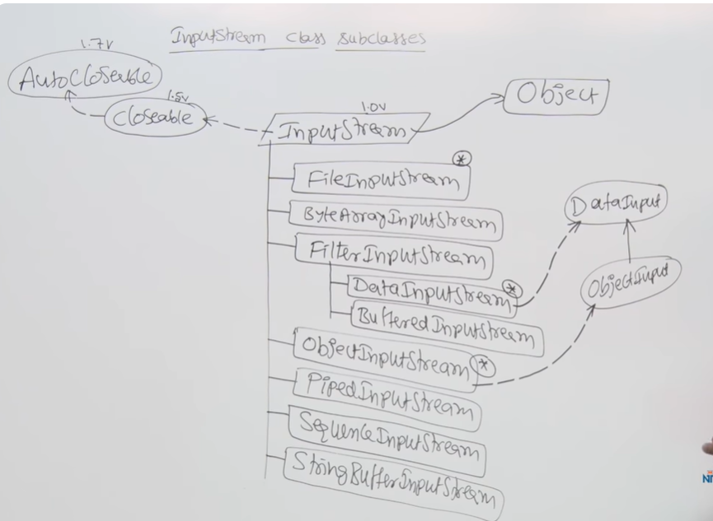

Slide 17
Streams in Java
In Java, a sequence of data is known as a stream.
This concept is used to perform I/O operations on a file.
There are two types of streams :
1. Input Stream:
The Java InputStream class is the superclass of all input streams. The input stream is used to read data from numerous input devices like the keyboard, network, etc. InputStream is an abstract class, and because of this, it is not useful by itself. However, its subclasses are used to read data.

Slide 18
2. Output Stream:
The output stream is used to write data to numerous output devices like the monitor, file, etc. OutputStream is an abstract superclass that represents an output stream. OutputStream is an abstract class and because of this, it is not useful by itself. However, its subclasses are used to write data.

Slide 19
Based on the data type, there are two types of streams
1. Byte Stream:
This stream is used to read or write byte data. The byte stream is again subdivided into two types which are as follows:
Byte Input Stream: Used to read byte data from different devices.
Byte Output Stream: Used to write byte data to different devices.

Slide 21
2. Character Stream:
This stream is used to read or write character data. Character stream is again subdivided into 2 types which are as follows:
Character Input Stream: Used to read character data from different devices.
Character Output Stream: Used to write character data to different devices.

Slide 22
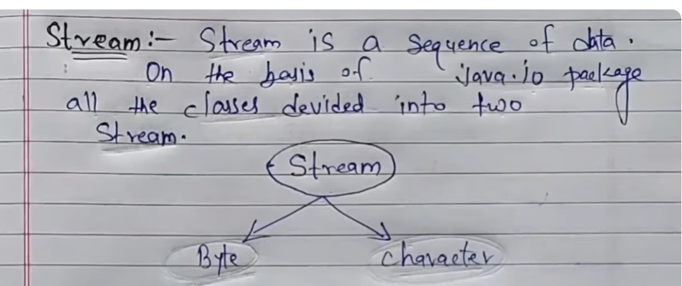

Slide 23
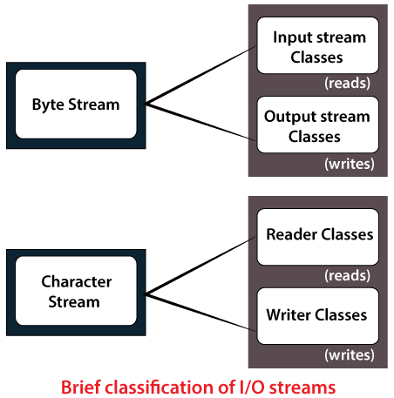

Slide 24
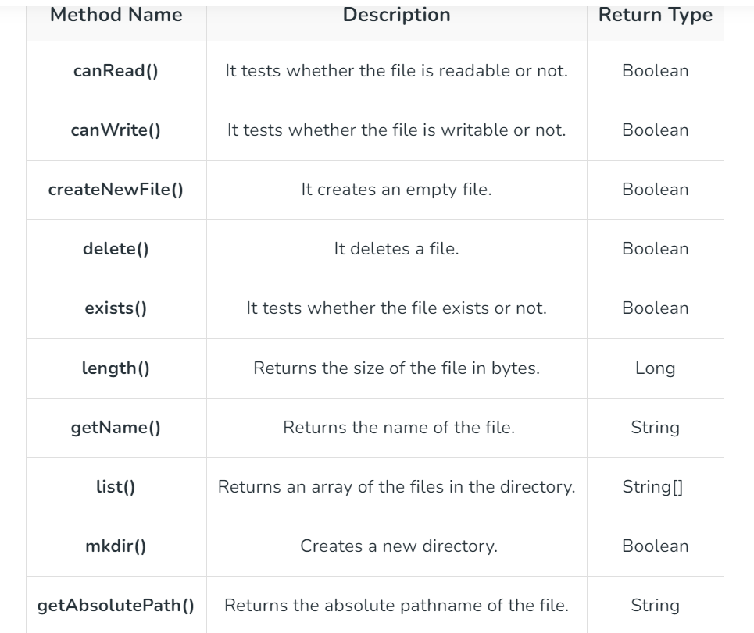
File class methods

Slide 25
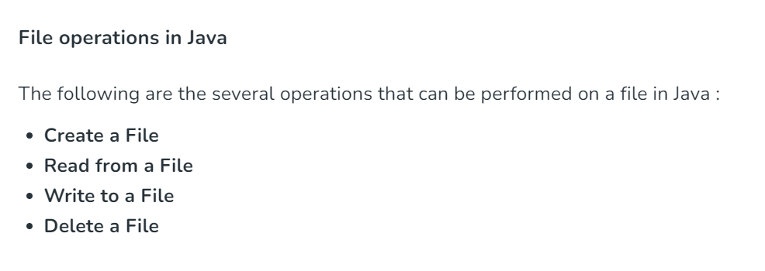

Slide 26
File write classes
Filewriter
Bufferedwriter
Fileoutputstream
PrintWriter

Slide 27
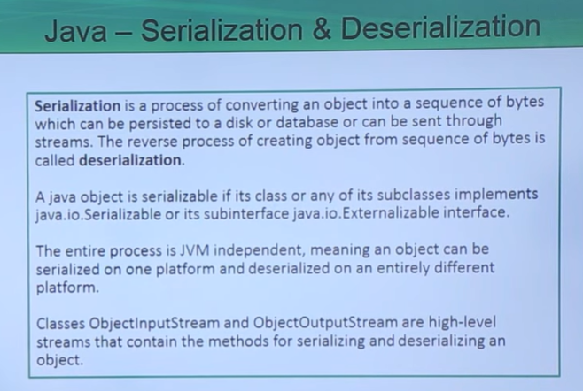

Slide 28
The transient keyword in Java is used to avoid serialization. If any object of a data structure is defined as a transient , then it will not be serialized. Serialization is the ​process of converting an object into a byte stream.

